Slide 1
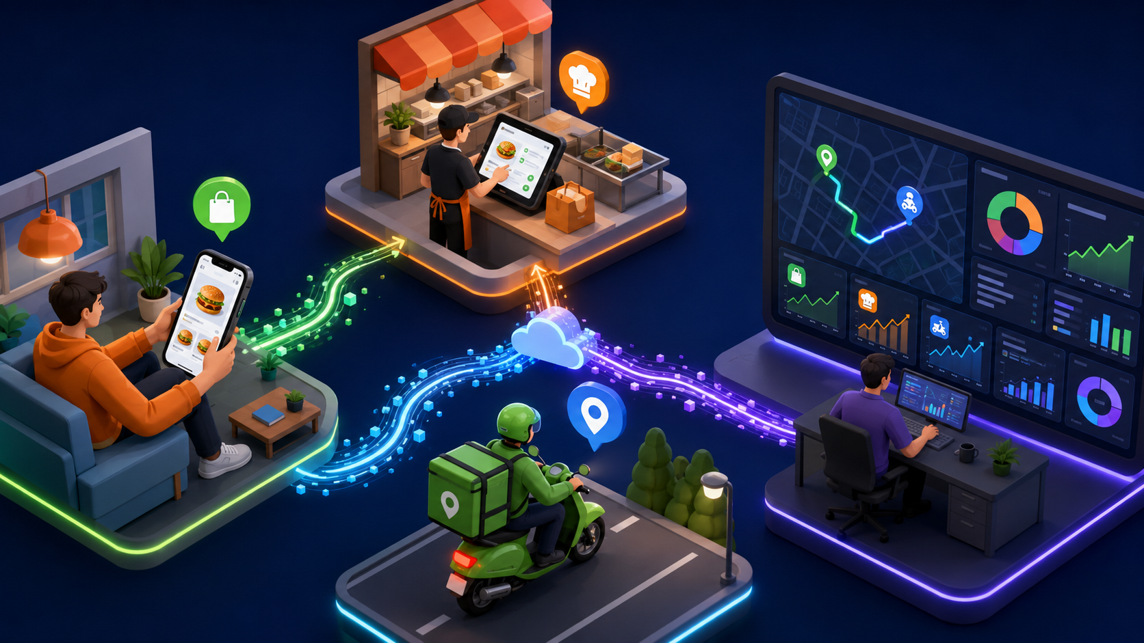
DATA ENGINEERING TRAINING
Introduction
to Streaming
How real-time events move from apps, devices, and systems into fast analytics and action.
Introduction to Streaming • 1
Notes:
Think about the last time you ordered food online. The app did not wait until the end of the day to confirm your order. It immediately told you that the order was placed, the restaurant accepted it, the driver picked it up, and the map started moving. That is the feeling of streaming.”
Then point to the title and say: “Today we are not learning only one tool. We are learning the data engineering idea behind real-time systems: data is generated continuously, it travels through a pipeline, it is processed quickly, and some action happens immediately.”
Set the learner expectation: “The slides will show only the main ideas. I will explain the full story using examples like food delivery, fraud detection, live dashboards, and Spark Structured Streaming

Slide 2
What students should understand
Learning objectives for this session
🌊
What streaming means
⚖️
Batch vs streaming
🏗️
Architecture
Continuous event processing
When each approach fits
Sources → broker → processor → sink
🍔
Real-world flow
⚡
Why it is fast
🧠
Key concepts
Food delivery live tracking
Low latency + continuous processing
Event time, windows, watermarks
Introduction to Streaming • 2
Notes:
Point to ‘What streaming means’: “Streaming means continuous event processing. Data does not arrive as one final file; it arrives as many small events.”
Batch vs streaming’: “You should know when a daily batch report is enough and when a real-time pipeline is required.
Architecture: You should understand the path: source systems create events, a broker buffers them, a processor transforms them, and sinks serve dashboards or alerts.
Real-world flow: We will use food delivery because everyone understands live order tracking.
Why it is fast:Speed comes from always-on processing, small chunks, parallelism, and immediate output. Key concepts: Event time, windows, and watermarks are where streaming becomes different from normal batch jobs.
Transition: “Now let us see why streaming exists in the first place.”

Slide 3
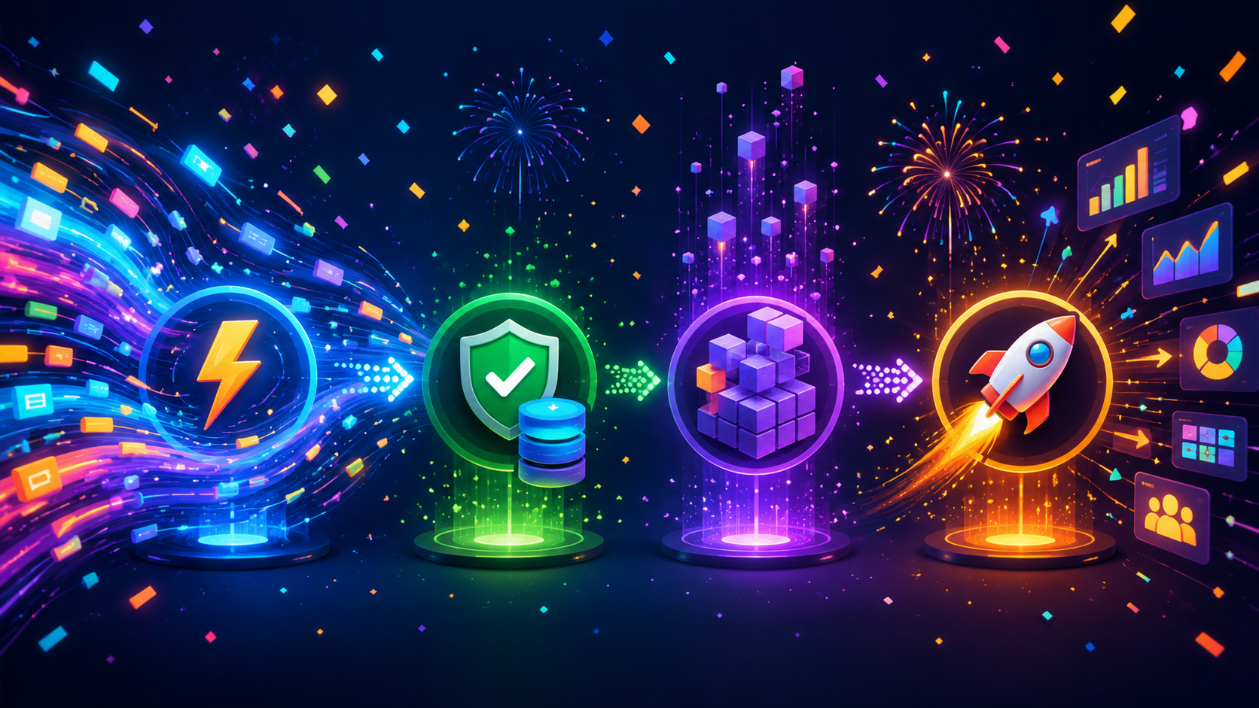
Why streaming exists
The business question is: “What is happening right now?”
• Customers expect instant updates
• Operations teams need live alerts
• Fraud and failures cannot wait for daily batch jobs
• Dashboards must update while events arrive
Streaming turns new data into action in seconds.
Introduction to Streaming • 3
Notes:
The main business question behind streaming is: what is happening right now?
first bullet: Customers expect instant updates. If they click Pay, they expect confirmation immediately. If a driver moves, the map should move.
second bullet: “Operations teams need live alerts. If many orders are delayed in Chennai right now, waiting for a night batch job is useless.
third bullet: Fraud and failures cannot wait. A suspicious payment must be blocked in seconds, not tomorrow morning.
fourth bullet: Dashboards are no longer only historical reports. Businesses want live dashboards showing current demand, current failures, current revenue, and current delays.
“Streaming turns new data into action in seconds. That is the business value.”
Transition: “Now that we know why it exists, let us define streaming clearly.”

Slide 4
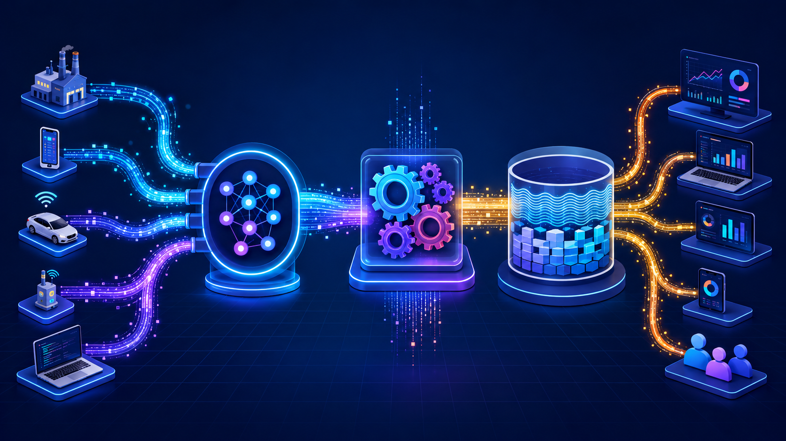
What is streaming?
Simple definition
Streaming is the continuous movement and processing of data events as soon as they are generated.
Example event
Order placed • Payment done • Driver moved • Sensor reading • Web click
Memory cue: LIVE = Listen • Inspect • Value • Emit
Introduction to Streaming • 4
Notes:
“Streaming is the continuous movement and processing of data events as soon as they are generated.”
An event is a small record that says something happened. Examples: order placed, payment completed, driver location changed, sensor temperature received, user clicked a button.”
Think of many sources pushing small dots of data into a pipeline. The system does not wait for a big file. It keeps listening.”
“In a food delivery app, every status change becomes an event. In banking, every card swipe becomes an event. In IoT, every sensor reading becomes an event.”
LIVE memory cue: “Listen means receive events. Inspect means validate and clean them. Value means calculate something useful. Emit means send the result to a table, dashboard, alert, or another service.”
Transition: “A common question is: how is this different from batch processing? Let us compare.”

Slide 5
Batch vs streaming
Both are important; they answer different questions
Question
Batch: what happened yesterday?
Streaming: what is happening now?
Data shape
Bounded dataset
Unbounded events
Run pattern
Scheduled job
Always-on query
Latency
Minutes to hours
Milliseconds to seconds
Example
Daily sales report
Live fraud alert
Batch is for complete historical views. Streaming is for immediate action.
Introduction to Streaming • 5
Notes:
Batch and streaming are not enemies. They solve different problems.
Batch answers ‘What happened yesterday? Streaming answers ‘What is happening now?
Batch has a bounded dataset. For example, yesterday’s sales file has a start and an end. Streaming is unbounded. Events keep coming.”
run pattern: “A batch job runs on a schedule, maybe every night. A streaming query is usually always on.
latency: Batch can take minutes or hours. Streaming aims for milliseconds or seconds.”
example row: Daily sales report is batch. Live fraud alert is streaming. Food delivery live tracking is streaming. Monthly revenue summary can still be batch.
In real data engineering platforms, we normally use both. Streaming gives immediate action; batch gives complete historical reporting.
Transition: Let us make this practical using a food delivery story.

Slide 6
Real-world example: Food delivery
Every action becomes an event
An order platform cannot wait until night to process data.
1
Customer places order
2
Restaurant accepts
3
Driver picks up
4
Customer tracks live
5
Ops sees alerts
Introduction to Streaming • 6
Notes:
Speaker story for this food-delivery slide:
Say: “Imagine a customer opens a food delivery app and places an order.”
Step 1: “Customer places order. The app creates an ORDER_CREATED event. This event may contain order_id, customer_id, restaurant_id, city, amount, and event_time.”
Step 2: “Restaurant accepts. That creates another event: RESTAURANT_ACCEPTED. The customer sees the status change.”
Step 3: “Driver picks up. The driver app sends PICKED_UP or OUT_FOR_DELIVERY events.”
Step 4: “Customer tracks live. Driver GPS keeps sending location events every few seconds.”
Step 5: “Operations sees alerts. If the restaurant takes too long or a driver is stuck, the operations dashboard receives a delay alert.”
Explain the bottom statement: “This platform cannot wait until night to process data because the customer experience depends on live updates.”
Transition: “Now let us identify all the places where streaming data can come from.”

Slide 7

Where does streaming data come from?
Many systems can be event producers
📱 Mobile apps
orders, clicks, locations
🌐 Websites & APIs
page views, transactions
🚗 IoT / GPS devices
sensor readings, movement
🧾 Databases
CDC change events
🛡️ Logs & security
errors, login attempts
Introduction to Streaming • 7
Notes:
Speaker story for this data sources slide:
Say: “Streaming data can come from many producers. A producer is any application, device, or system that emits events.”
Mobile apps: “A food app emits orders, clicks, payments, and location changes.”
Websites and APIs: “A website emits page views, searches, cart actions, purchases, and API transactions.”
IoT and GPS devices: “Sensors send temperature, pressure, vibration, and vehicle movement events.”
Databases: “Databases can emit change-data-capture events when rows are inserted, updated, or deleted.”
Logs and security: “Application logs, login attempts, error messages, and suspicious behavior can all be streamed.”
Trainer tip: “Ask students to name one system they use daily and identify what events it can produce.”
Transition: “Once these sources produce events, they need a pipeline. Let us look at the architecture.”

Slide 8
Streaming architecture
A practical data engineering pipeline
Producer
→
Broker
→
Processor
→
Sink
→
Consumer
Apps, DBs, sensors
Kafka / Event Hubs
Spark / Flink
Lakehouse / DB
Dashboards / alerts
Introduction to Streaming • 8
Notes:
Speaker story for this architecture slide:
Say: “This is the core streaming architecture. Read it from left to right.”
Producer: “The producer is the source: mobile apps, databases, sensors, logs, or APIs. It creates events.”
Broker: “The broker is the buffer and traffic controller. Kafka, Event Hubs, or Pub/Sub can receive events from many producers and hold them safely.”
Processor: “The processor is where business logic happens. Spark or Flink reads the events, filters bad records, enriches data, aggregates metrics, or detects delays.”
Sink: “The sink is where the result goes: lakehouse tables, databases, search systems, dashboards, or alert queues.”
Consumer: “The consumer is the final user or system: operations team, customer app, fraud service, or reporting dashboard.”
Close: “A strong data engineer should be able to draw this pipeline for any real-time use case.”
Transition: “The most misunderstood component is often the broker, so let us zoom into that.”

Slide 9
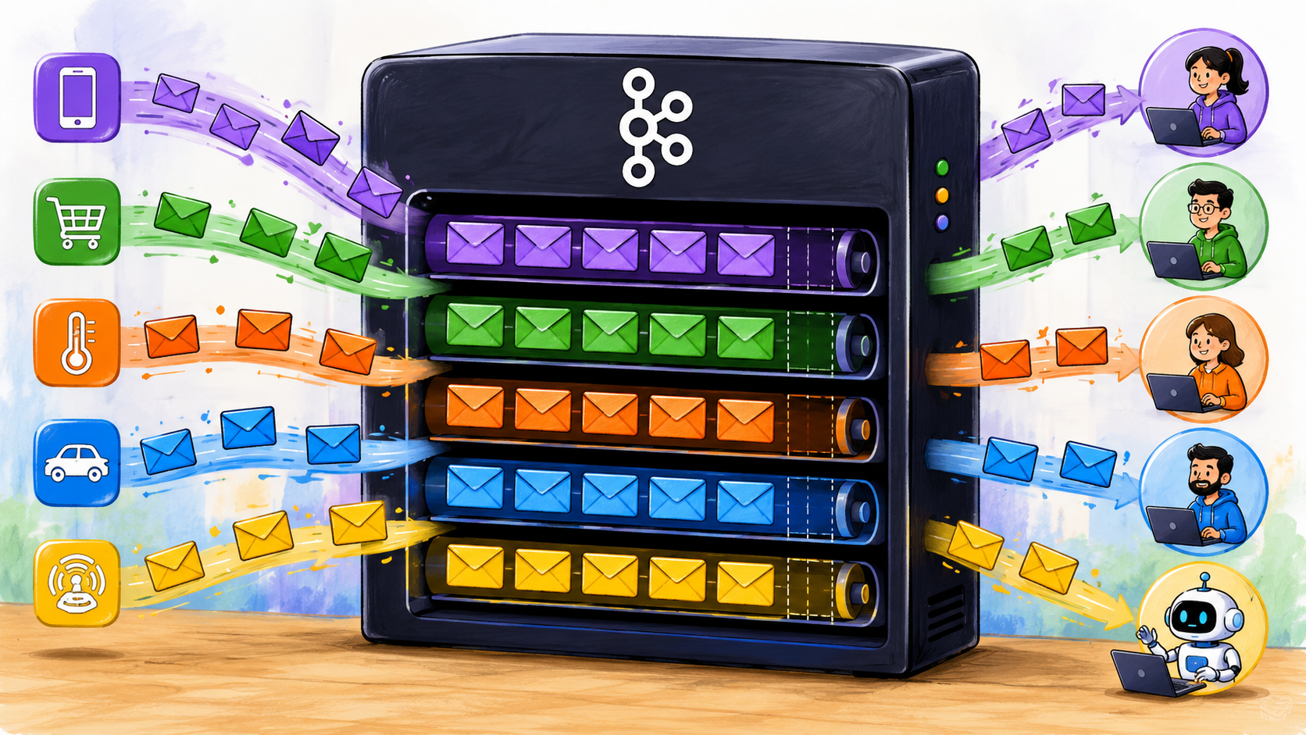
Message broker: the traffic controller
Buffers events and allows many consumers
• Receives events from producers
• Stores messages safely
• Partitions for scale
• Lets consumers read at their own pace
Common tools: Kafka • Azure Event Hubs • Pub/Sub
Introduction to Streaming • 9
Notes:
Speaker story for this broker slide:
Say: “A message broker is like a traffic controller and waiting area for events.”
Explain receives events: “Many producers can send events at the same time. The broker receives them and organizes them.”
Explain stores messages safely: “If the processor is temporarily slow or down, the broker keeps messages for a retention period instead of losing them immediately.”
Explain partitions: “Partitioning allows the broker to split traffic across multiple lanes. This helps scale throughput.”
Explain consumers read at their own pace: “Different consumers can read the same stream for different purposes. One consumer can update a dashboard; another can store raw data; another can detect fraud.”
Use a simple analogy: “It is like a railway station. Trains bring passengers, platforms hold them, and different exits take them to different destinations.”
Transition: “Now let us connect this to speed. Why does streaming feel fast?”

Slide 10
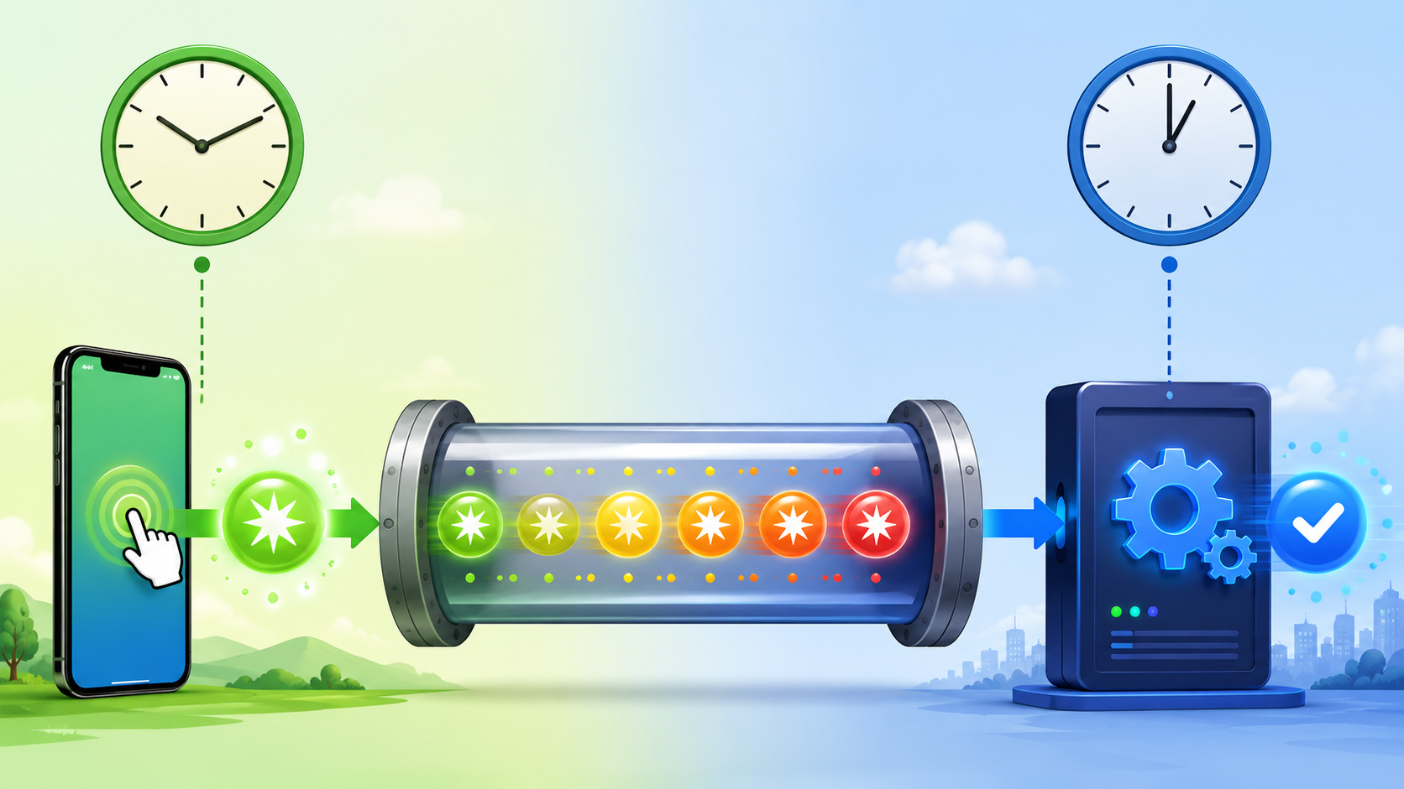
How streaming becomes fast
It avoids waiting for a full file or full day
Always listening
Queries run continuously
Small chunks
Process events/micro-batches
Parallel work
Partitions distribute load
Immediate sinks
Dashboards and alerts update quickly
Introduction to Streaming • 10
Notes:
Speaker story for this speed slide:
Say: “Streaming becomes fast because the system avoids waiting for a complete file or a full day of data.”
Always listening: “The query is already running. It does not start only after someone uploads a file.”
Small chunks: “Instead of processing one huge dataset later, the engine processes events or micro-batches continuously.”
Parallel work: “Partitions allow many workers to process different portions of the stream at the same time.”
Immediate sinks: “The result is written quickly to a dashboard, alert system, table, or API.”
Food delivery example: “When the driver location changes, the event flows immediately and the customer map updates. That is low latency.”
Close: “Fast does not mean careless. The system still needs reliability, checkpoints, and monitoring.”
Transition: “Now let us see where Spark Structured Streaming fits into this.”

Slide 11
Spark Structured Streaming
Stream processing using DataFrame logic
Input Stream
Streaming Query
Output Sink
Kafka
Files
Socket
Cloud queues
filter
select
groupBy
window
Console
Delta Lake
Database
Dashboard
→
→
Introduction to Streaming • 11
Notes:
Speaker story for this Spark Structured Streaming slide:
Say: “Spark Structured Streaming lets us process streaming data using the same DataFrame-style logic many of you already know.”
Input stream: “Input can come from Kafka, files arriving in a folder, socket data for demos, or cloud queues.”
Streaming query: “This is where we write transformations. We filter invalid records, select columns, group data, calculate counts, and create windows.”
Output sink: “The result can go to console for learning, Delta Lake for storage, database for serving, or dashboard for live monitoring.”
Key explanation: “A streaming DataFrame is like a table that keeps receiving new rows. The query keeps applying the same logic as new data arrives.”
Micro-batch explanation: “In many Spark jobs, Spark processes streaming data in very small batches. The user gets near real-time results while still using DataFrame operations.”
Transition: “Let us see what a live dashboard receives from this kind of pipeline.”

Slide 12
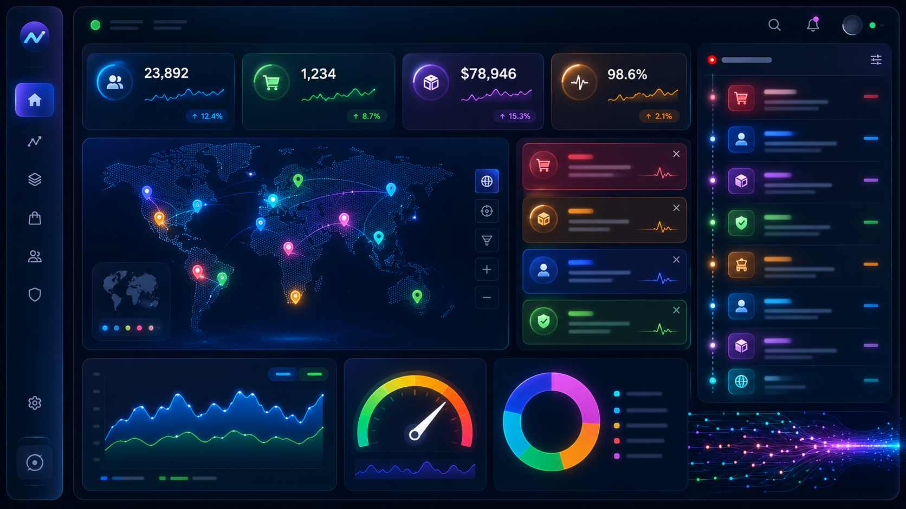
Live dashboard: what changes in real time?
Metrics update as events arrive
Orders/min
Current demand
Delayed orders
Operations alert
Revenue by city
Live business pulse
Driver movement
Customer tracking
Introduction to Streaming • 12
Notes:
Speaker story for this live dashboard slide:
Say: “A dashboard is one of the most visible outputs of streaming.”
Orders per minute: “This tells the business current demand. If orders suddenly increase, operations can react.”
Delayed orders: “This is an alert metric. If delayed orders cross a threshold, the team can call the restaurant or reassign drivers.”
Revenue by city: “This shows the live business pulse. Managers can see which city is active right now.”
Driver movement: “This powers customer tracking and operations monitoring.”
Explain the main idea: “The dashboard is not waiting for a final daily CSV. It is being refreshed as events are processed.”
Trainer example: “Ask students what metric they would show live if they owned this food-delivery company.”
Transition: “To make live metrics correct, we must understand event time and processing time.”

Slide 13
Event time vs processing time
A key reason streaming can be tricky
Event time
When the real-world event happened
Processing time
When the engine processed it
Late events happen when event time is older than processing time.
Introduction to Streaming • 13
Notes:
Speaker story for this event-time slide:
Say: “Event time and processing time are extremely important in streaming interviews and real projects.”
Event time: “This is when the real-world event actually happened. Example: the driver reached the restaurant at 10:15:05.”
Processing time: “This is when the engine processed the event. Example: Spark processed it at 10:15:12.”
Explain late events: “If the network is slow, the event may arrive late. The actual event happened earlier, but the system sees it later.”
Food delivery example: “A driver may lose network for 30 seconds. When the phone reconnects, old location updates may arrive late.”
Why it matters: “If we calculate ‘orders per 5 minutes’ using processing time only, late events may be counted in the wrong time bucket.”
Transition: “The next concept, windows and watermarks, solves this counting problem.”

Slide 14
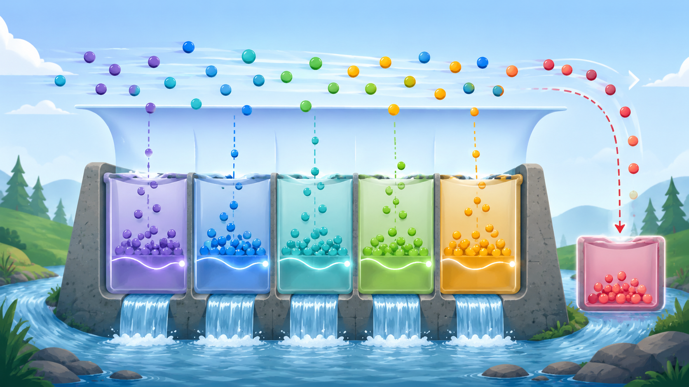
Windows and watermarks
Counting continuously arriving events
Window
Groups events by time interval.
Example: orders every 5 minutes.
Watermark
Controls how long we wait for late events.
Introduction to Streaming • 14
Notes:
Speaker story for this windows and watermarks slide:
Say: “When events never stop arriving, we need time buckets to calculate useful metrics.”
Window: “A window groups events into intervals. For example, count orders every 5 minutes: 10:00 to 10:05, 10:05 to 10:10, and so on.”
Use the buckets image: “Imagine each bucket as one time window. Events fall into the correct bucket based on event time.”
Watermark: “A watermark tells the system how long to wait for late events. Example: accept late events up to 10 minutes.”
Explain trade-off: “Longer waiting gives better accuracy for late data, but it keeps more state in memory and costs more. Shorter waiting reduces memory but may drop very late events.”
Food delivery example: “If a driver’s phone sends a late update, the watermark decides whether we still include it in the earlier window.”
Transition: “Now let us talk about reliability when failures and retries happen.”

Slide 15
Delivery guarantees
What happens if failures or retries occur?
At most once
At least once
Exactly once
Fast, but events may be lost
No loss, but duplicates may appear
Final result updated once
Good for low-risk telemetry
Common with retries
Requires end-to-end support
Data engineers design deduplication and idempotent sinks to protect final results.
Introduction to Streaming • 15
Notes:
Speaker story for this delivery guarantees slide:
Say: “In streaming, failures and retries are normal. We must understand delivery guarantees.”
At most once: “An event may be lost, but it will not be processed again. This is fast but risky. It may be acceptable for low-risk telemetry.”
At least once: “The event will not be lost, but it may be processed more than once. This is common because systems retry when uncertain.”
Exactly once: “The final result is affected once, but this requires support across broker, processor, checkpointing, and sink.”
Important warning: “Exactly once is not a button. It is an end-to-end design.”
Food delivery example: “If ORDER_CREATED is processed twice, the dashboard may count two orders unless we deduplicate using event_id.”
Close: “That is why data engineers design idempotent writes and deduplication.”
Transition: “This pattern appears across many industries, not just food delivery.”

Slide 16
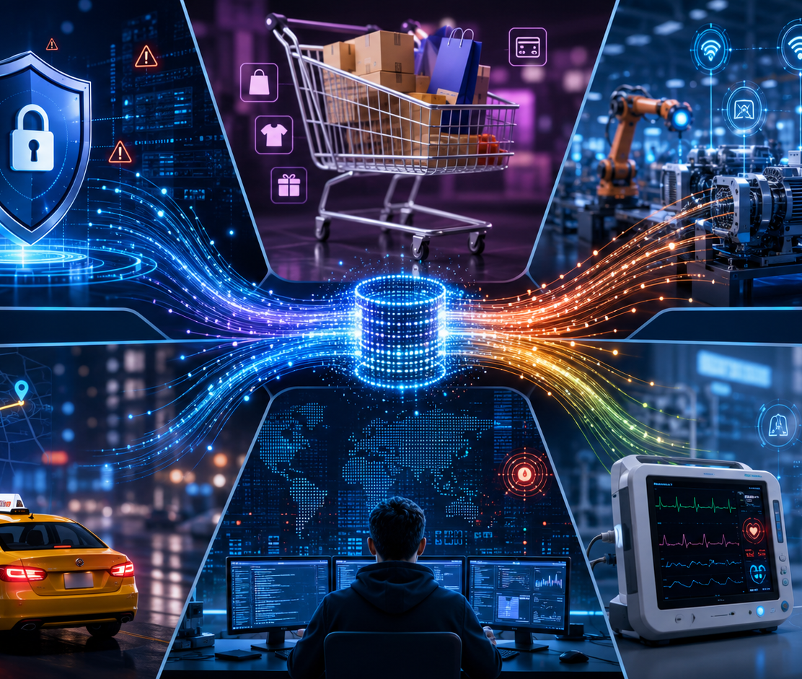
Real-world streaming applications
The same pattern appears across industries
🏦 Banking
🛒 E-commerce
Fraud detection
Inventory + orders
🏭 Manufacturing
🚕 Transport
Machine monitoring
Live location
🏥 Healthcare
🛡️ Security
Patient device alerts
Log anomaly detection
Introduction to Streaming • 16
Notes:
Speaker story for this applications slide:
Say: “The same streaming pattern repeats across industries.”
Banking: “Card transactions are streamed to detect fraud immediately.”
E-commerce: “Orders, payments, carts, and inventory events update recommendations and stock status.”
Manufacturing: “Machine sensors stream temperature and vibration data to detect failures early.”
Transport: “Vehicles send GPS locations for live tracking and ETA prediction.”
Healthcare: “Devices can stream patient readings and trigger alerts.”
Security: “Logs and login attempts are streamed to detect suspicious behavior.”
Trainer question: “Which of these examples can wait for a nightly batch? Which examples need streaming? Let students answer.”
Transition: “Streaming is powerful, but it also comes with design challenges.”

Slide 17
Streaming challenges
Fast systems still need careful design
Late data
Duplicates
Ordering
Network delays make events arrive late
Retries can publish the same event again
Distributed systems may reorder events
Backpressure
Schema changes
Cost & state
Input may exceed processing capacity
Producers evolve over time
Long windows retain more data
Introduction to Streaming • 17
Notes:
Speaker story for this challenges slide:
Say: “Fast systems are not automatically correct. Streaming needs careful engineering.”
Late data: “Events may arrive late because of mobile network delays, system retries, or temporary outages.”
Duplicates: “A producer may retry and send the same event again. Without event_id, deduplication becomes difficult.”
Ordering: “In distributed systems, events may not always arrive in the exact order they happened.”
Backpressure: “If input is faster than processing, the pipeline falls behind. This creates lag.”
Schema changes: “Producers may add or rename fields. Consumers must handle schema evolution safely.”
Cost and state: “Long windows and large state stores increase memory and storage cost.”
Close: “Good streaming design means planning for these problems from day one.”
Transition: “Let us convert these problems into a practical design checklist.”

Slide 18
Design checklist for streaming pipelines
Practical rules for data engineers
✓
Define event schema and version it
✓
Include unique event_id and event_time
✓
Use a reliable broker for buffering
✓
Checkpoint state and progress
✓
Handle duplicates and bad records
✓
Monitor lag, latency, failures, cost
Introduction to Streaming • 18
Notes:
Speaker story for this checklist slide:
Say: “This slide is a practical checklist you can use when designing streaming pipelines.”
Schema and versioning: “Define the event structure clearly. If the producer changes the schema, consumers should not break suddenly.”
Unique event_id and event_time: “event_id helps deduplicate. event_time helps place the event into the correct time window.”
Reliable broker: “A broker gives buffering, retention, and decoupling between producers and consumers.”
Checkpoint: “Checkpointing allows the streaming job to restart from the last known progress instead of starting blindly.”
Duplicates and bad records: “Separate bad records into a dead-letter path or quarantine table. Do not allow bad data to silently corrupt metrics.”
Monitor lag and latency: “Streaming jobs are always-on, so monitoring is part of the solution, not an afterthought.”
Transition: “Now we will connect the design to PySpark Structured Streaming commands.”

Slide 19
PySpark Structured Streaming: key commands
Students see the flow; presenter explains code
readStream
Create streaming input DataFrame
transform
filter / select / groupBy / window
writeStream
Send output to sink
checkpoint
Save progress for recovery
awaitTermination
Keep query running
Structured Streaming uses familiar DataFrame operations for continuous data.
Introduction to Streaming • 19
Notes:
Speaker story for this PySpark commands slide:
Say: “This slide shows the skeleton of almost every Spark Structured Streaming program.”
readStream: “This creates a streaming input DataFrame. Example sources are Kafka, files, socket, or cloud queues.”
transform: “Here we write normal DataFrame logic: filter, select, groupBy, joins, windows, or aggregations.”
writeStream: “This defines where results go: console, Delta table, database, memory table, or another stream.”
checkpoint: “This saves progress and state. Without checkpointing, recovery after failure becomes unreliable.”
awaitTermination: “This keeps the streaming query alive. Unlike batch jobs, a streaming job should keep running.”
Explain the mental model: “The code looks like DataFrame code, but the input table keeps growing and Spark repeatedly processes new data.”
Transition: “Let us now connect all pieces into a full food-delivery pipeline.”

Slide 20
End-to-end food delivery pipeline
From event creation to business action
The value is not only collecting data. The value is reacting to it.
1
Customer app emits ORDER_CREATED
2
Kafka stores event safely
3
Spark validates and aggregates
4
Dashboard updates live metrics
5
Alert service notifies operations
Introduction to Streaming • 20
Notes:
Speaker story for this end-to-end pipeline slide:
Say: “Now we can tell the full story from event creation to action.”
Step 1: “The customer app emits ORDER_CREATED with order_id, customer_id, city, amount, and event_time.”
Step 2: “Kafka stores the event safely. This protects us if Spark is slow or temporarily unavailable.”
Step 3: “Spark validates and aggregates. It filters invalid records, groups by city, counts orders, calculates revenue, and detects delays.”
Step 4: “The dashboard updates live metrics such as orders per minute, revenue by city, active drivers, and delayed orders.”
Step 5: “The alert service notifies operations if delay rules are violated.”
Explain the sentence: “The value is not collecting data. The value is reacting to it quickly and reliably.”
Close: “This is what a complete streaming data engineering pipeline looks like.”
Transition: “Let us summarize the main things students should remember.”

Slide 21
Key takeaways
What learners should remember
Streaming
Events
Broker
Processor
process data while it arrives
small records of what happened
decouples producers and consumers
applies validation and analytics
Windows
Watermarks
Checkpoint
Monitoring
group events by time
handle late arrivals
enables recovery
keeps always-on jobs healthy
Introduction to Streaming • 21
Notes:
Speaker story for this key takeaways slide:
Say: “Let us quickly revise the eight ideas on this slide.”
Streaming: “Process data while it arrives, instead of waiting for a complete dataset.”
Events: “Small records describing what happened.”
Broker: “Decouples producers and consumers and provides buffering.”
Processor: “Applies validation, transformation, aggregation, and business rules.”
Windows: “Group events by time so we can calculate metrics continuously.”
Watermarks: “Handle late arrivals with a controlled waiting period.”
Checkpoint: “Stores progress and state for recovery.”
Monitoring: “Keeps always-on jobs healthy by tracking lag, latency, failures, and throughput.”
Close: “If learners can explain these eight words with a real example, they understand the foundation of streaming.”
Transition: “Now we will use discussion questions to test whether the idea is clear.”

Slide 22
Discussion / Q&A
Use these prompts to check understanding
1. Where is streaming needed in your current project?
2. What event would your system publish?
3. What needs to be shown in real time?
4. What could still remain batch?
Introduction to Streaming • 22
Notes:
Speaker story for this discussion slide:
Say: “I want you to apply streaming to your own project or a system you use daily.”
Question 1: “Where is streaming needed? Look for places where waiting creates business loss, poor customer experience, or operational risk.”
Question 2: “What event would your system publish? Example: ORDER_CREATED, PAYMENT_FAILED, DRIVER_LOCATION_UPDATED, TEMPERATURE_EXCEEDED, LOGIN_FAILED.”
Question 3: “What needs to be shown in real time? It could be a live dashboard, alert, map, notification, fraud score, or availability status.”
Question 4: “What can remain batch? Monthly reports, historical reconciliation, and deep analytics can often remain batch.”
Close the session: “Streaming is not only a technology. It is a way of designing systems that react to data as it happens.”
Optional activity: “Ask each student to draw Producer → Broker → Processor → Sink → Consumer for one use case.”

